Slide 1
Agenda
Time | Contents
15 min. | Presentation | 1. Project overview 2. Architectural driver 3. Perspective view 4. Architectural Design 5. Design & Implementation 6. Wrap up
15 min. | Demo | 1. Add home node 2. Add mail box 3. Away / Secure mode 4. Add rule 6. Malfunction 7. Show Log
10 min. | Q & A
Notes:
DBR2 : 센서 / 엑츄에이터 예제 서술
DBR3 : 센서 구조 예제 그림 그리기

Slide 2
IoT Management System (Final Presentation)
Team 2

Slide 3
Contents
1. Project Overview
2. Architectural Driver
3. Architectural Overview
4. Design & Implementation
5. Conclusion

Slide 4
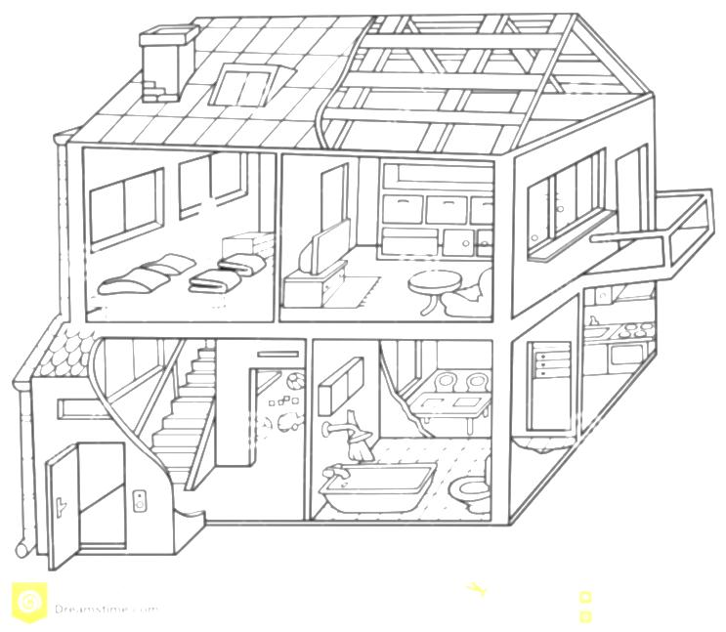




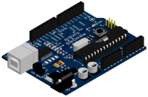



1. Project Overview
Overview
Our Team is working for an organization that intends to enter the IoT market.
We make an Internet of Things(IoT) system that enables end-users to communicate with sensors and actuators installed in the home or business via PC or smartphone connected to the internet.
(For example, indoor and outdoor light, temp and humidity sensor, door open-close actuator, door open-close sensor, secure alarm, presence/proximity sensor)
Temp.
sensor
Presence
Sensor
Light
Secure Alarm
Humidity
sensor
Arduino
Door
Open-Close
Wi-Fi
router
Notes:
DBR2 : 센서 / 엑츄에이터 예제 서술
DBR3 : 센서 구조 예제 그림 그리기

Slide 5
2. Architectural Drivers
2.1. Context
2.2. Stakeholders
2.3. Functional Requirements
2.4. Quality Attributes Utility
2.5. Constraints

Slide 6
2.1 Context - Market, Organizational
Market Context
Stakeholders | Customer, End-user, System Installer, Developer
System Access | Users want to access the system via PC, Mobile devices
Functional expectations | After system installation, users expect the system to work automatically by assigned rules of sensors and actuators
Environment | There are many vendors developing a system, sensors and actuators. But there is no standard of interface.
Organizational Context
Roles and responsibilities | Project Manager(includes planning, risk and configuration, schedule) Architect Requirement Manager Test Manager Documentation Manager Developer (all members)
Technical background | Digital-Appliance SW solution researcher & developer Smart-phone SW developer Camera module testing SW developer
Notes:
DBR4 :Any more assumptions? Such as using commonly found sensors, actuators to reduce cost? Using open source apps. Would the browser be different for mobile devices and PC's :
DBR5 : How about planning manager, risk manager, configuration manager, customer liaison? If you sourced these roles from a framework then which one?
DBR6 : Very broad. Can you be more specific, consumer durable goods, or IT or government products?

Slide 7
2.1 Context - Business, Technical
Business Context
Date of Delivery | 26 June 2015
Time Resources | 498 man-hours (48+450) :48 man-hours (8 hours X 6 people) in Korea :450 man-hours(3 hours X 6 people X 5 days X 5 weeks) in CMU
Strategy | Easy to use & high extensibility for sensors/actuators
Target Market | B2B - Building Architect Office, B2C - DIY User
Profit Model | Rental Service, Standalone, System Education, Maintenance
Future direction | Many kinds of sensors/actuators(indoor air quality sensor, camera, thermostat controller and so forth) is used & it makes a lot of use case. So big-data of these cases would enable to make services of IoT System.
Technical Context
Development Skills | Java , C, JavaScript, HTML5
Platforms | Arduino Platform, Laptop Computers
Tools | Eclipse, Arduino IDE
OS | Windows, Linux
HW platform | Arduino , X86
Notes:
DBR7 : May be better to consider hours here instead of 7 weeks. Would that be a better measure of to use for determining what you can get done?
→ working day 3hours, Weekend 8hours
DBR8 : Such as? Examples
→ 센서 : 조도 센서, 거리센서, 컬러 스펙트럼 센서 , 카메라
→ actuator : 온도 조절기 , 조도 조절기 , ????
DBR9 : this is good to consider technical risks early.

Slide 8
2.2 Stakeholders
Stakeholders of the IoT Management System (IoTMS)
Customer
End-User
System Installer
Application Developer
Value-added-resellers (VARs)
Service Provider
Maintainer
Project consultant (or mentor)
Notes:
DBR10 : How about project consultant, or mentor too?
DBR 11 : Good, but usually in the US we spell out the acronym first and then in parens give the acronym. As is this is OK

Slide 9
2.3 Functional Requirement
Req. ID | Description
FR-12 | The system should make it easy for developers to implement new protocol about new devices.
FR-13 | The system provides user define scenario service like IFTTT(IF This Then That)
FR-14 | When the system sends emergency message, it will be E-mail. In future, it can be SMS or tweet.
FR-15 | When sensors value is abnormal(out of range), the system sends an alarm message to user.
FR-16 | User sets configurations of E-mail address, logging-duration, secure response time and lights waiting time.
FR-17 | The system provides Web APIs for Web developer.
Notes:
DBR15 : added by whom

Slide 10
2.4 Quality Attributes Utility
QA Type | ID | Description | Priority | Difficulty
Availability | QA-01 | Server recognizes malfunction of sensors within 10 seconds. | High | Medium
 | QA-08 | Detect and notify Logging failure in 30 seconds. | Low | Low
Usability | QA-02 | All function of System is served in 3 depth UI. | Low | Medium
Scalability | QA-03 | IoTMS allow up to 50 SA Nodes. | High | Medium
Modifiability | QA-04 | Emerging new protocol, it is possible to be developed in 2 man-months. | Medium | Medium
Security | QA-05 | IoT Management System allow only authorized user to access in secure way. | High | Medium
Testability | QA-06 | 80% of test cases can be tested within 1 day. | Medium | Medium
Performance | QA-07 | The response time of controlling and monitoring is within 10 seconds. | Medium | High
Modifiability | QA-09 | The System allows to add an new rule without additional development. | Medium | High

Slide 11
2.5 Constraints
Business Constraints
ID | Description
CST-01 | Schedule Limitation: 7 weeks(include a plan-time in Korea) 498 man-hours (48+450) :48 man-hours (8 hours X 6 people) in Korea :450 man-hours(3 hours X 6 people X 5 days X 5 weeks) in CMU
CST-02 | Human Resources: 6 people
CST-03 | User can’t buy SA nodes and sensors/actuators separately.
Technical Constraints
ID | Description
CST-01 | End-user communicates with sensors/actuators via PC or Smartphone connected to the Internet.
CST-02 | An SA node has 1 or more sensors/actuators.
CST-03 | An SA node uses Wi-Fi communication(802.11)
CST-04 | The IoTMS should be made by Java Language & Arduino device
CST-05 | The IoTMS works on PC or Server
Notes:
DBR21 : As recommend use hours, may be a better granualrity. Weeks implies a work week of 40 hours minimum. Willl you have that much time? DBR22 : Another area where minimum may be better for planning. And it isn't 7 people? Also, are all developers?

Slide 12
3. Architectural Design
3.1. System Context Diagram
3.2. Allocation view
3.3. Dynamic view

Slide 13
3.1 System Context View
Node
IoTMS
<< Display information >>
User Authorization Success / Fail
Node Authorization Success / Fail
Set Rule Success / Fail
Display Log information
- Node information
- Node information for registration
Sensing Data : Temperature/Humidity/Door /Presence(proximity)/Mail Box
Command :
Door on/off, light on/off,
alarm on/off
- Register node
Log In
Register User
Add, Delete Node
Set Customize rule
Log information
Set Alarm mode (Secure / Unsecure)
Door on/off
- Light on/off
Legend
: System Element
: User
: Data flow
: User action(Event) to IoTMS

Slide 14




3.2 Allocation View
Home PC
Web Browser
Mobile device , office PC
Web Browser
Internet
http
IoTMS
http
Web Server
(apache-tomcat-8.0.23)
Legend
http
Port #8080(User)
Database
(mariadb-10.0.19)
TCP
Port #550
(Arduino)
IoTMS
Server
Machine
Windows 7
Data
repository
TCP
Port #3250(Discovery)
TCP
Port #3250(Discovery)
TCP
Port #3250(Discovery)
Sensor
first node
second node
50th node
User
Machine
arduino-1.0.6
arduino-1.0.6
……..
arduino-1.0.6
node
Arduino
node
Door
Door
Mail
box
Senor 1
Actuator 1
SW on Machine
Temp.
&Humi.
Alarm
……..
…..
…..
Actuator
Proxi.
Light
Senor N
Actuator N
Router
11/32

Slide 15
3.3 Dynamic Perspective View
Web UI
User DB
Log DB
event bus
watchdog
e-mail
twitter
Rule DB
Legend
message
confirm
A
B
kick
reset
: JSON event , from A to B
User Interface Manager
Log Manager
Message Manager
Rule Manager
A
B
: information, from A to B
A
B
: TCP/IP , from A to B
E v e n t B u s + J S O N
DB
Manager
Communication
Manager
Node Manager
Thing object
(Sensor, actuator...)
Node object
Node
Node
Node
Link object
Link
Link
SA node (Arduino)
Things object List
user access
JSON
JSON
actuators
sensors
Default
sensors
thread
SA
actuators
sensors
Default
sensors
Home , mail box , …. , 50th node
12/32

Slide 16
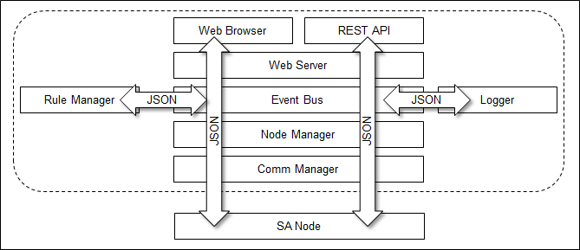
3.3.1 Design Decision – Event Bus w/ JSON
Event Bus
Advantage | Disadvantage
Less coupling 2) Provides extensibility 3) Easy to track the interaction between packages | Single point of failure Solution: Recovery Mechanism 2) Performance on heavy duty Solution: Reduce System Load 3) Concurrency Solution: Queuing
Why JSON?
Less coupling Cross platform Human readable UI and SA Node speak the same language UI (Java Script) and database friendly

Slide 17
4. Design & Implementation
4.1. Security
4.2. Availability
4.3. Modifiability
4.4. Scalability & Performance

Slide 18
4.1.1 Security – User Management
[Design decision]
User Access
View
Framework :
- Spring framework can filter user access with URL Pattern.
- It uses access filter xml, so it applies user access control easily
- should be necessary to study framework.
Spring Intercept
URL
Spring validates
[Login failed]
In-House :
- If using cookie, It can develop simply.
- But we can apply just web page. According to implementation, it cannot apply at Web API.
- And it is more chance to mistake.
[Login successful]
Spring displays
View
Spring displays
error message
Spring shows
Login page
User Enter
id & password

Slide 19
4.1.2 Security – Secure Connection
SA Node
IoTMS
Test Environment
Performance Consideration for Arduino RSA 32bit AES 128bit Random Key Generation
Generate
SK_{node}
PubK_{IoTMS}
E_{PubKIoTMS}(SK_{node})
Decrypt
D_{PrvKIoTMS}(E_{PubKIoTMS}
(SK_{node}))
E_{SKnode}(SerialNumber)
Decrypt
D_{SKnode}(E_{SKnode}
(SerialNumber))
E_{SKnode}(Result)
Decrypt
D_{SKnode}(E_{SKnodeo}(Result))
Figure) Secure Node Registration Sequence
SA Node
IoTMS
Generate
SK_{node}
E_{PubKIoTMS}(SK_{node})
E_{SKnode}(Result)
Decrypt
D_{PrvKIoTMS}(E_{PubKIoTMS}(SK_{node}))
Decrypt
D_{SKnode}(E_{SKnode}(Result))
E_{SKnode}(Data)
Decrypt
D_{SKnode}(E_{SKnodeo}(Data))
Figure) Secure Node Connecting Sequence

Slide 20
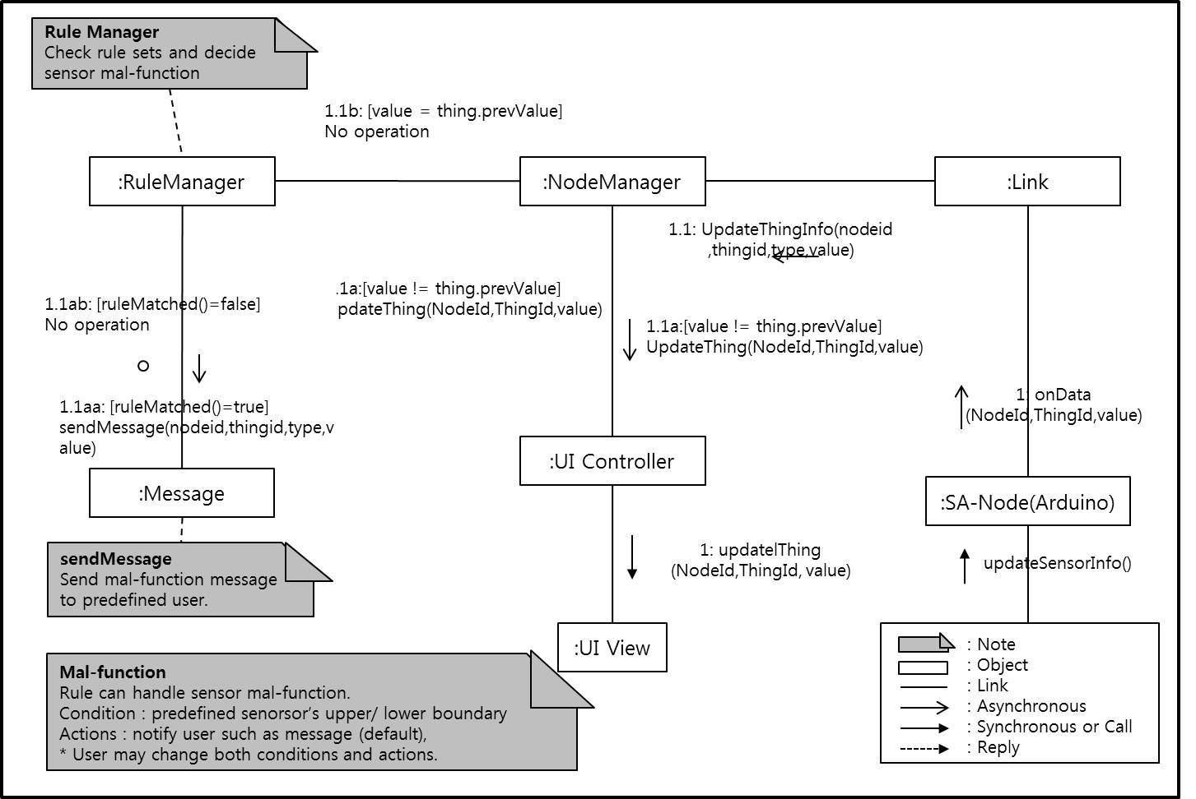
4.2.1 Availability – Sensor Malfunction.

Slide 21
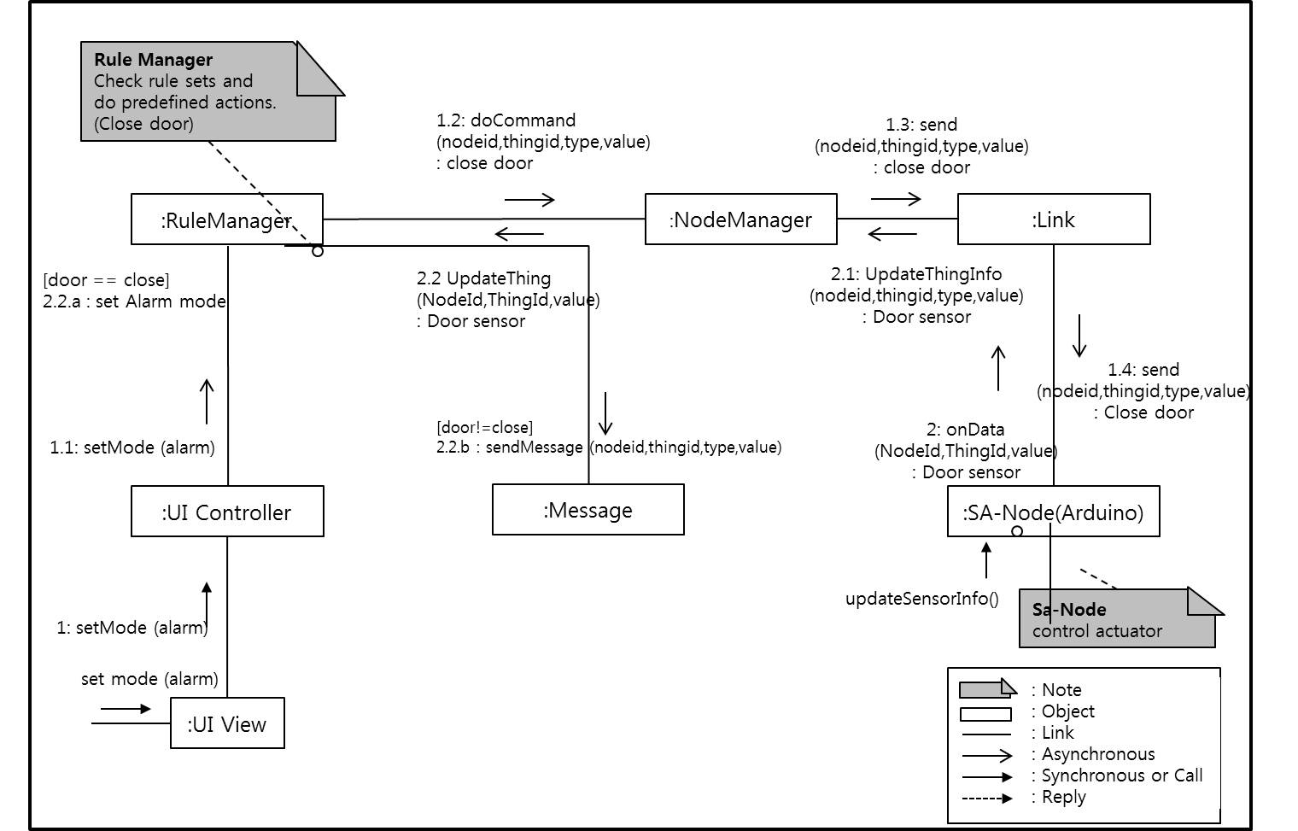
4.2.2 Availability – Actuator Malfunction.

Slide 22
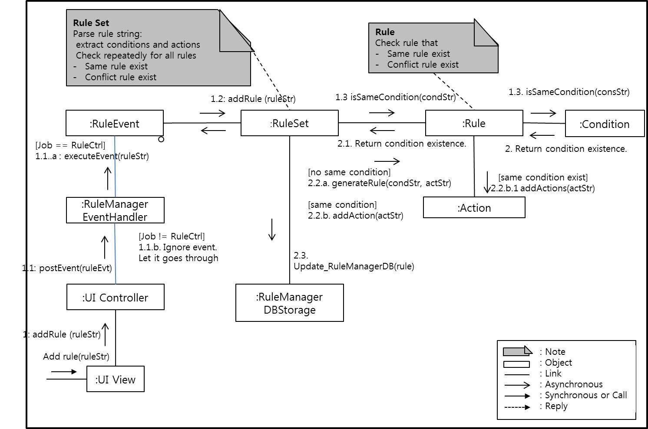
4.3.1 Modifiability - User Defined Rule
if nodeB@temp==Over35#Temperature and nodeA@preseceA==AtHome#Presence
then nodeB@aircon=On@AirConditioner
Rule := if {conditions} then {actions} [condition := {nodeID}@{thingID}=={Value}#{Type}(Delay)?]

Slide 23
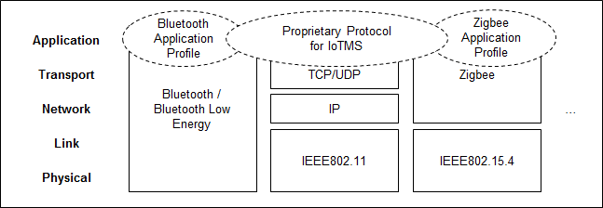
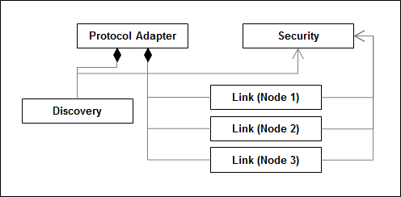

4.3.2 Modifiability - Support Emerging Protocol
Figure) Protocol Stacks for SA Nodes
Figure) Structure of Protocol Adapter
Category | Operation | Parameter | Description
Discovery | discover | duration | Find adjacent SA nodes
 | register | secure key | Register the discovered node
 | unregister |  | Remove the node from the registered list
Link | connect |  | Connect to the node
 | disconnect |  | Disconnect from the node
 | send | data | Send data with JSON format
 | receiver | data | Receive data with JSON format

Slide 24

4.4 Performance Evaluation
Environement
IoTMS : Intel i5 2.7Ghz, 4GB RAM
2nd PC for 500 virtual SA Node
SA Node : Arduino
Experiment Steps
Run IoTMS Connect a Real SA Node to IoTMS IoTMS send Ping to Real SA Node every 1sec The second PC creates Virtual Nodes made for simulation The second PC makes Node increase 1 per every sec Node sned Thing information to IoTMS every 3sec The second PC makes Node increase until 500ea We measure response of echo from Real SA Node
Web Browser
Simulator
Simulating 50 SA Nodes
Legend
http
Server
Machine
IoTMS
node
Arduino
node
TCP
Port #3250~3300
(Discovery)
IoTMS
Data
repository
SW on Machine
Web Server
(apache-tomcat-8.0.23)
http
Port #8080(User)
TCP
first node
Windows
PC
Router
Database
(mariadb-10.0.19)
TCP
Port #550
(Arduino)
arduino-1.0.6
Windows 7

Slide 25
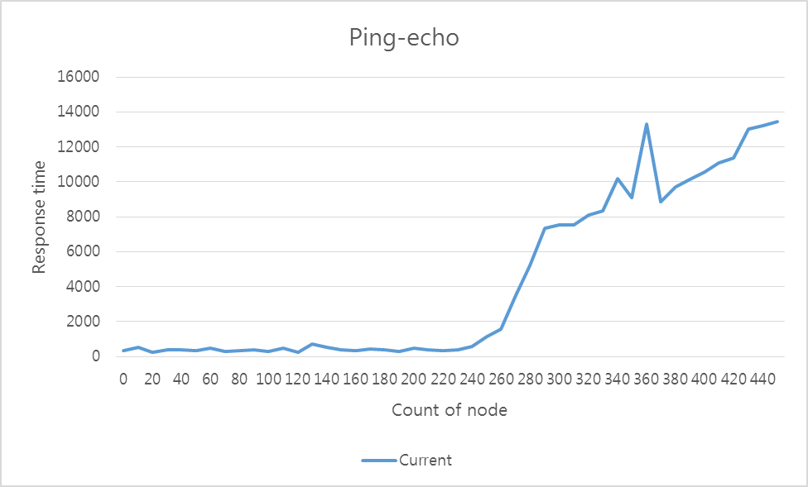
4.4 Scalability and Performance
Result of Ping-echo
Node 340 (Response > 10s)
Node 250

Slide 26
4.4 Scalability and Performance
How we solve IoTMS overload?
degrade gracefully
If Nodes are 250 or more,
Event period change from 3 seconds to 6 seconds
IoTMS
IoTMS
Send information
every 3 sec
Send information
every 6 sec
Node
Node
Node
Node

Slide 27
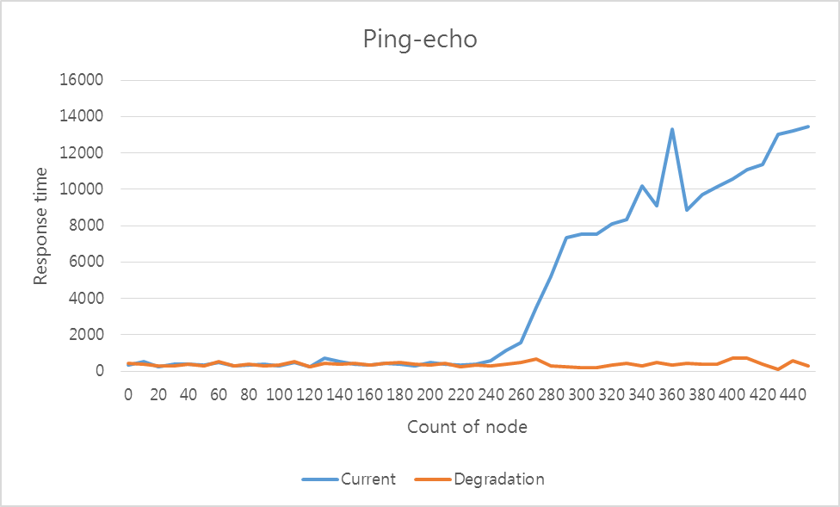
4.4 Scalability and Performance
Result of experiment with degradation
Node 340 (Response > 10s)
Node 250

Slide 28
5. Wrap up
5.1. Time Log and Earn Value
5.2. Role and Responsibility
5.3. Lessons Learned

Slide 29
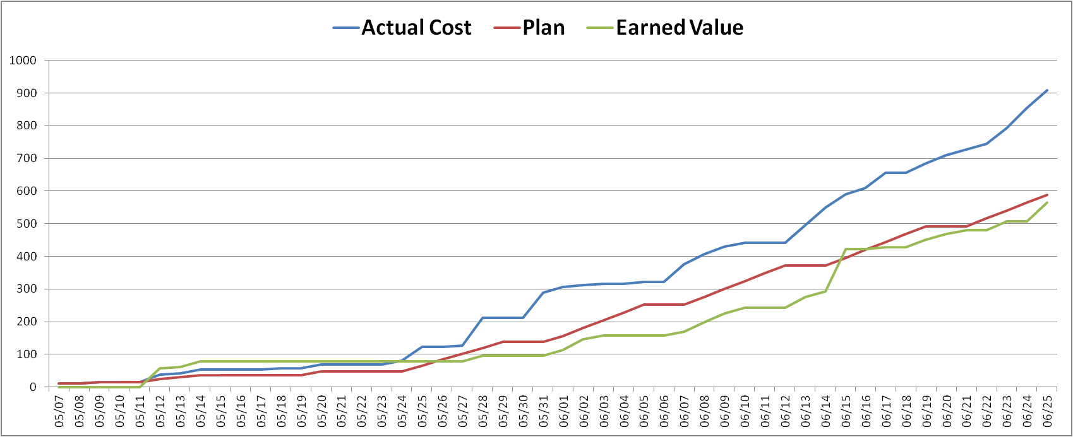
5.1 Time log & Earn Value
hour
gap A
→ Long discussion and late decision about architecture design.
gap B
→ Underestimate workload.
Earn
Value
(hour)
gap C
→ Put the more resource to experiment & implementation.
gap C
gap A
gap B
W1
W2
W3
W4
W5
W6
W7
W8
Plan
Analysis (architecture driver)
Time
Log
Design( system context, perspective view )
implementation
Module test
System test
Documentation
KOREA
CMU

Slide 30
5.2 Role & Responsibility
Role | Responsibility |  | Assign
Project Manager | Risk & Issue Management , Schedule Management |  | JONGHYUN HAN
Architect | Requirement Analysis , Architecture Design |  | YOUK KWON
Requirement Manager | Requirement Management |  | JANG YOUNG KEUN
Test Manager | Test Strategy , Test Plan , Test Management |  | DONGOG MIN
Time Log Manager | Time log management , Earned value management |  | JUNG BO HYUN HYUN JIN WOOK
Development | IoTMS | User Interface manager , Log manager , message manager | JONGHYUN HAN
 |  | Rule manager | JUNG BO HYUN
 |  | Node manager | DONGOG MIN
 |  | Communication manager | YOUK KWON
 |  | Event bus + JSON | HYUN JIN WOOK
 | Arduino |  | JANG YOUNG KEUN HYUN JIN WOOK

Slide 31
5.3 Future Needs and Lessons Learned
* Future Need
1. Implement adding emerging protocols.(Bluetooth, Zigbee..etc)
2. Implement the encryption (AES, RSA…etc) JSON message between IoTMS and Node.
3. Implement watchdog for single point failure recovery of event bus.
* Lesson Learned
1. Stop discussion, do experiment. - A.J. Lattanze
→ Schedule was delayed for a long meeting about design decision.
Arduino memory constraint
→ Technical constraint matters.
3. Decoupling is good.
→ Because we use the Event bus and JSON, it’s easy to integrate the modules.
4. Manner make the good team work

Slide 32
Demo Scenario
1. User Login
2. Add Home Node
1. Discover (SA Node home)
2. Register (Serial Number for Security)
3. Home Node Event Update
1. Door Open by alarm, Turn on the light
4. Add MailBox Node
5. MailBox Node Event Update
6. Away mode
1. Send Confirm Message (Twitter Phone)
2. Automatic Door Close, Light off
7. Secure mode : Human Break-in
1. Unknown coming in
2. Emergency message (Tweete)
3. Turn off Alarm
8. Add Rule
1. Open door if mail arrives
2. Add invalid rule
9. Malfunction
1. Sensor (Pin out )/ Actuator (Door)
2. Remove Node
10. Show Log
Notes:
DBR2 : 센서 / 엑츄에이터 예제 서술
DBR3 : 센서 구조 예제 그림 그리기

Slide 33

Questions

Slide 34
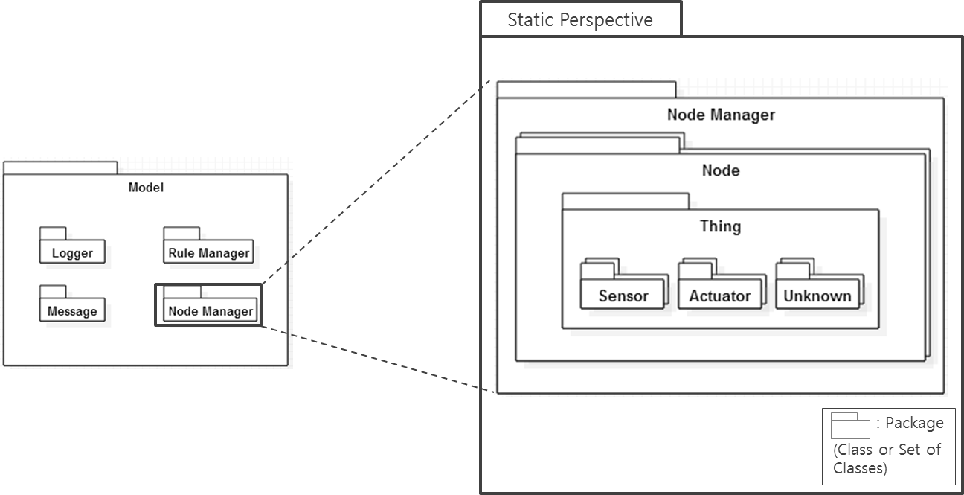
Appendix
Static view of Node Manger

Slide 35
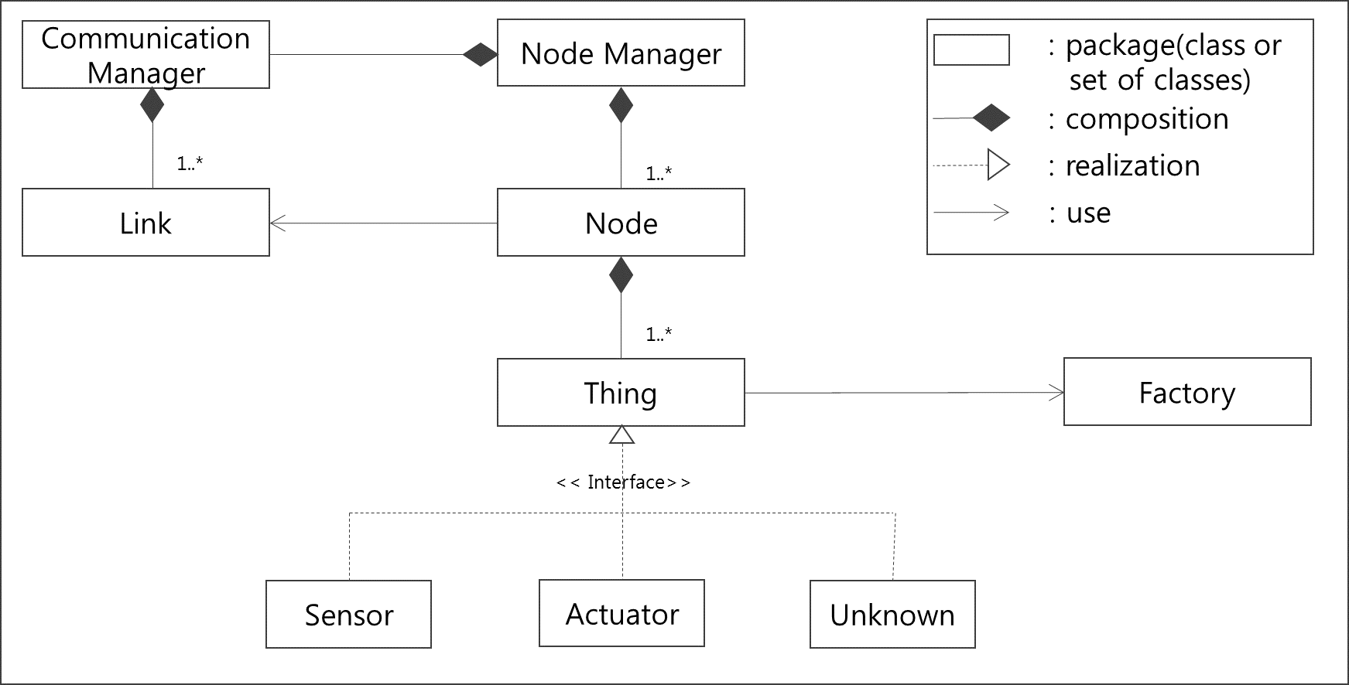
Appendix
Static view of Node Manager

Slide 36
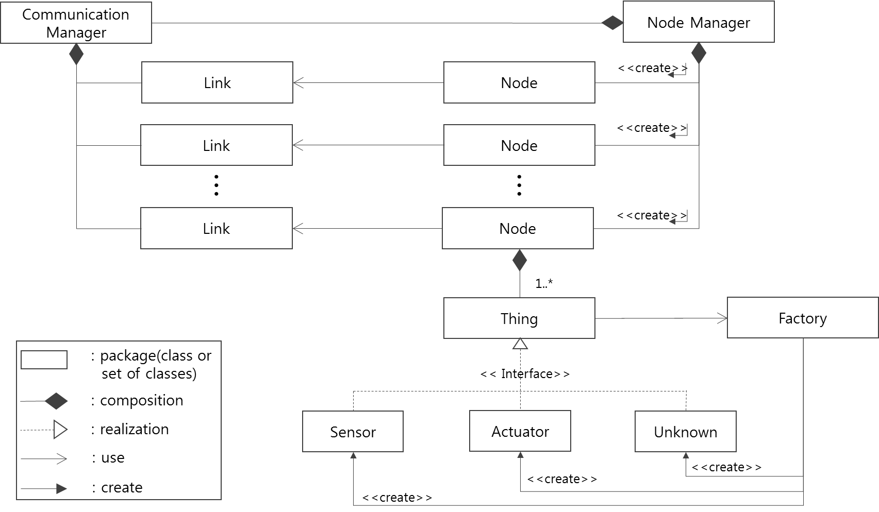
Appendix
Static view of Node Manager

Slide 37
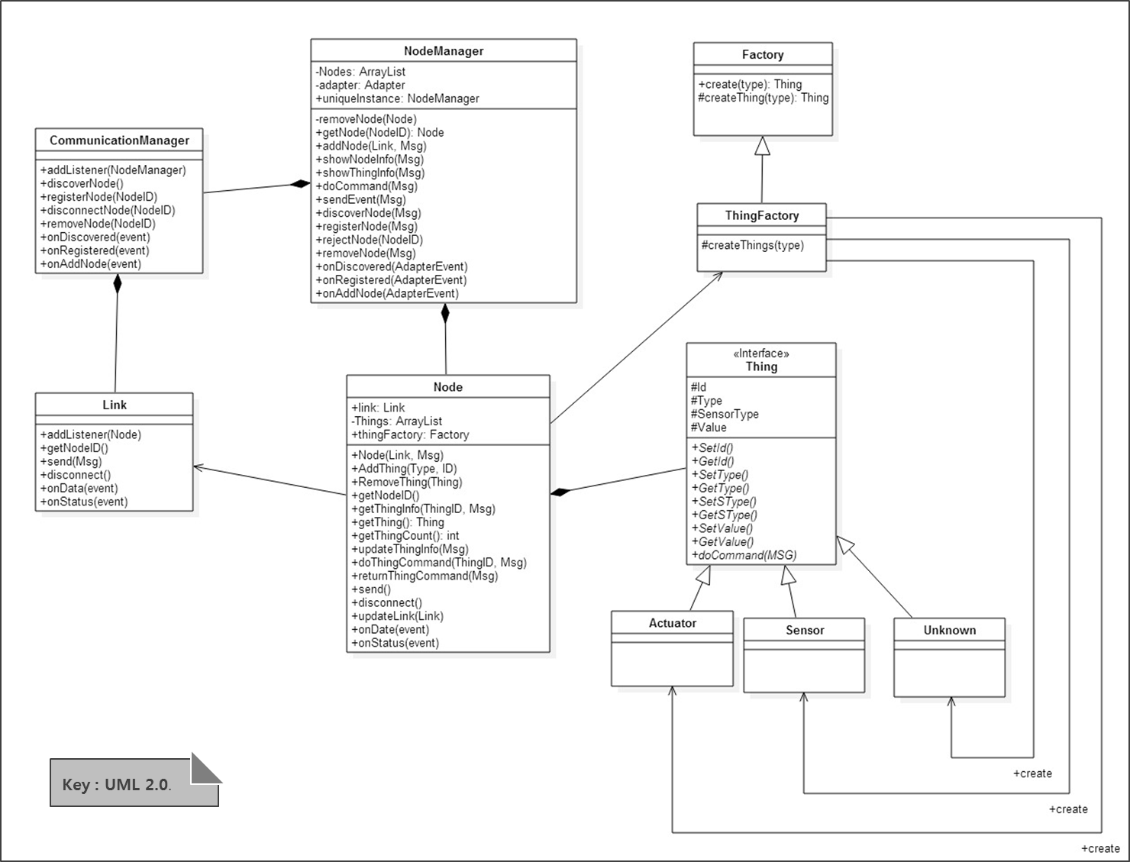
Appendix
Class Diagram of Node Manager

Slide 38
Appendix
Communication Diagram: addNode
addNode is called by Discover when SA-node registered successfully.
Create
newly created instance
Iteration
Loop to create thing
addNode(NodeId, Link)
2: addNode(ThingList, Link)
2.1*: [i:=0…ThingsList.size()]
: createThing(Type, Id)
:NodeManager
:Node
:ThingFactory
2.2: create(Type, Id)
1: getThingList(NodeId)
Type is used for distinguishing Sensor and Actuator.
:Thing
:DB
Create
newly created instance
: Note
: Object
: Link
: Asynchronous
: Synchronous or Call
: Reply

Slide 39
Appendix
Communication Diagram: registerNode
Security
PubKey : IoTMS’s public key. This key is used for sharing SessionKey.
SessionKey : made by SA-Node. This key is used for communicating between SA-Node and IoTMS.
1.2: registerNode(NodeId, ServerInfo, Serial)
:NodeManager
:Discover
1.5: onRegisterEvent
(Result, ThingList)
1.6: onRegisterEvent
(Result, ThingList)
1.3: Register(NodeId, ServerInfo, PubKey)
1.4: Registered
(E_{PubKey}(NodeId, SessionKey)
1.1: registerNode(NodeId, ServerInfo, Serial)
1.5: Authenticate
(E_{SessionKey}(NodeId, Serial))
1.6: Authenticated
(E_{SessionKey}(Result, ThingList))
:UI Controller
:SA-Node(Arduino)
1.7: updateRegister
(Result)
1: registerNode(NodeId, Serial)
1.6a: [Result=Autorized]
storeThings(ThingList)
:UI View
:DB
: Note
: Object
: Link
: Asynchronous
: Synchronous or Call
: Reply
registerNode(Serial)
Sa-Node verify for security whether serial input from user is the same with SA-Node’s.
Serial is input by User. User can recognize it from SA node’s physically label.

Slide 40
Appendix
Communication Diagram: removeNode
This removeNode is sending remove command and disconnecting Node.
removeNode is called by User.
removeNode(NodeId)
1: removeNode()
1.1: removeNode()
:NodeManager
:Node
:SA-Node(Arduino)
2: removeNode(NodeID)
SA-Node return to status waiting for discover when it receive removeNode().
This removeNode is removing Node object of NodeManager.
: Note
: Object
: Link
: Asynchronous
: Synchronous or Call
: Reply

